Slide 1
SDSC8007 • MINI PROJECT
Facial Keypoints
Regression
This presentation covers the end-to-end pipeline for predicting 15 facial keypoints (30 outputs) from 96×96 grayscale images, including data preprocessing, CNN modeling, K-Fold training, and Kaggle inference.l construction, and performance evaluation for the Kaggle mini-competition.
TEAM
COMPETITION
VioletEG
Facial Keypoints Regression
kaggle.com/competitions/mini-project-facial-keypoints-detection
DATE
TAGLINE
2026-04-28
End-to-end CNN pipeline: BaselineCNN → ImprovedCNN, 5-Fold CV, masked MSE loss, Kaggle submission.
CITYU-DG
Final Presentation
01
Notes:
大家好，欢迎参加我们的项目最终展示。本次报告将详细介绍我们在“面部关键点回归”这个迷你项目中的工作。我们的团队由Tianran Zhang, Yongjia Zhang和Shilpi Roy组成。我们将分享我们如何理解任务、分析数据、构建模型，并最终取得了竞赛中的第85名。接下来，我们将按照标准的建模流程，为大家展示我们的完整工作。

Slide 2
FINAL PRESENTATION TEMPLATE
USE AS ROADMAP
Recommended Storyline
COURSE REMINDER
EDITING TIP
Presentation should reflect the complete modeling pipeline: data understanding, validation design, baseline, model improvement, result analysis, and summary.
Delete this slide in the final version if you do not want to show the roadmap. Duplicate section slides when you need more space.
01
02
03
04
05
Task & metric
Data & challenges
Baseline
Improvements
Results & reflection
What is the competition? What is the exact prediction target and evaluation metric?
What data do you have, and what makes the task difficult?
Start from a reproducible model before improvements.
Show the logic behind each major change and its effect.
Final score, Top-5 target, what worked, what remains.
SDSC8007 • Mini Project • Facial Keypoints Detection
02
Notes:
本次报告将遵循一个清晰的故事线，分为五个部分。首先，我们会明确任务的定义和评估标准。其次，我们将深入分析数据集并识别其中的挑战。接着，我们会介绍我们建立的基线模型。然后，详细阐述我们为提升模型性能所做的各项改进。最后，我们会展示最终的结果，并进行反思总结。这个结构将帮助大家系统性地了解我们的项目全过程。

Slide 3
SDSC8007 • MINI PROJECT
TASK OVERVIEW
1. Task Description & Metric
COMPETITION SNAPSHOT
Task Visualization Concept
OFFICIAL METRIC
Name:Facial Keypoints Detection
Domain:Kaggle / SDSC8007 Mini Project
Impact:Fundamental for face recognition, emotion detection & AR.
Imagine a grayscale portrait of a human face.
Our model analyzes the pixel data to pinpoint 15 critical landmarks:
• Eyes (inner/outer corners) • Nose (tip & bridge) • Mouth (corners, upper/lower lips) • Jawline & Eyebrows
Output: 30 numbers (15 pairs of x, y).
Name: RMSE (Root Mean Squared Error)
Interpretation: Lower = Better. Computed only on labeled keypoints (masked).
Implementation: MaskedMSELoss + rmse_with_mask() — NaN labels excluded from loss.
PREDICTION SETUP
• Type:Regression (predict continuous coordinates)
• Input:2D Grayscale Facial Images
• Output:The (x, y) coordinates of 15 distinct facial keypoints.
YOUR GOAL
Build a CNN model predicting 30 continuous values (x,y for 15 keypoints), trained with K-Fold CV and evaluated by masked RMSE on Kaggle.ints for unseen grayscale face images, with the aim of minimizing the Mean Squared Error (MSE) on the test set.
SDSC8007 • Mini Project • Facial Keypoints Detection
01
Notes:
首先，我们来明确任务。本次竞赛是关于面部关键点回归，目标是预测图像中15个面部关键点的坐标。输入是灰度图像，任务类型是回归。官方评估指标是均方误差（MSE），我们的目标是尽可能降低这个值。这个任务在人脸识别、情绪检测等领域有重要应用。我们的核心目标就是构建一个高精度的预测模型。

Slide 4
SDSC8007 • MINI PROJECT
KEY INSIGHTS
2. Data Analysis & Challenges
DATASET SNAPSHOT
PREPROCESSING
MAIN CHALLENGES
1. Parse pixel string → reshape to 96×96 numpy array → divide by 255.0.
2. Build mask (masks = ~np.isnan(targets)); fill NaN → 0 for training.
• Up to ~70% of images missing labels for some keypoints.
• Sparse labels require MaskedMSELoss to exclude NaN targets from loss/metric.
• Scale:~7,049 training images; ~1,783 test images.
• Resolution:96x96 pixels (grayscale), resulting in 9216-dimensional feature vectors.
• Key Task:Localize facial keypoints (e.g., eyes, nose, mouth) from the 2D images.
• Input Space:High dimensionality poses a risk of overfitting simple models.
TAKEAWAY
TrainData dataclass stores images, targets, masks, and target_columns. Mask ensures missing labels never contribute to training loss.g the high dimensionality (9216 features) is essential to avoid overfitting and improve model efficiency.
High Dimensionality
9216-D (96×96) → CNN extracts spatial features
Label Issues
Missing Values & Sparse Keypoints
Data Quality
Requires Strict Normalization & Centering
Data Analysis • Key Findings & Obstacles
04
Notes:
接下来是数据分析与挑战。我们的数据集包含约7000张带标签的训练图像。每个图像是96x96的灰度图，展平后是一个9216维的向量。主要挑战包括：部分样本存在缺失的关键点标签，这需要我们进行预处理；并非所有关键点在每张图中都可见，导致标签稀疏；以及测试集可能存在与训练集不同的姿态或光照，即领域漂移问题。这些分析告诉我们，数据预处理和降维将是关键。

Slide 5
SDSC8007 • MINI PROJECT
START SIMPLE
3. Baseline CNN
BASELINE PIPELINE
WHY THIS BASELINE?
3 Conv-ReLU-MaxPool blocks → Flatten → FC(512) → Dropout(0.3) → FC(30 outputs).
BaselineCNN captures spatial patterns via convolutions. Serves as a reproducible benchmark before adding BN, Dropout2d, and a larger head in ImprovedCNN.
Preprocess
Input Features
Model Type
Loss & Train
Pixel string → 96×96 / 255.0
1×96×96 grayscale image tensor
BaselineCNN (3 Conv blocks + MLP head)
MaskedMSELoss + AdamW optimizer
Interpretation
Public RMSE 3.81 shows that a simple CNN already learns meaningful keypoint structure. Improvements via BN + Dropout2d + larger head should push this lower.cantly lower MSE to demonstrate effectiveness. The linear model serves as a sanity check to ensure data loading and pipeline are correct.
MODEL SUMMARY
LEADERBOARD SCORE
input → Conv32 → Conv64 → Conv128 → FC512 → Dropout(0.3) → out30. Simple reproducible benchmark.
Public: 3.81359 — Baseline benchmark.
Baseline: BaselineCNN — 3-Block Conv Net
03
Notes:
我们的基线模型非常简单。我们首先将图像像素值归一化到0到1之间，然后直接使用展平后的9216维向量作为输入，训练一个线性回归模型。损失函数采用均方误差。这个模型在公共排行榜上取得了3.81958的分数。选择线性回归作为基线是因为它简单、可解释，能为我们提供一个性能基准，方便后续评估更复杂模型的改进效果。

Slide 6
SDSC8007 • MINI PROJECT
SHOW REASONING
4. ImprovedCNN & Training Strategy
ImprovedCNN: BN + Dropout2d + Larger Head
HYPOTHESIS
Adding BatchNorm stabilizes training; Dropout2d regularizes; deeper head (1024→512→30) increases capacity.
SDSC8007 • Mini Project • ImprovedCNN + K-Fold CV

Slide 7
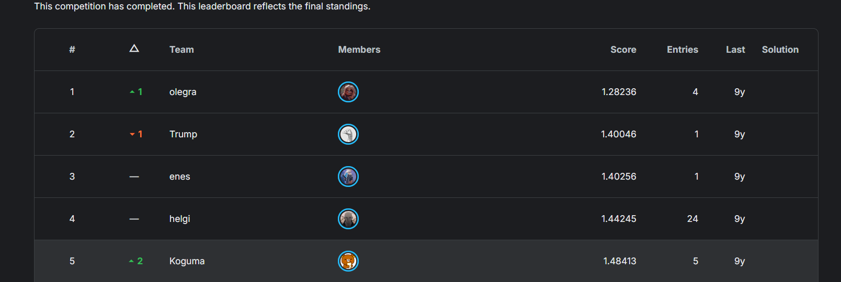
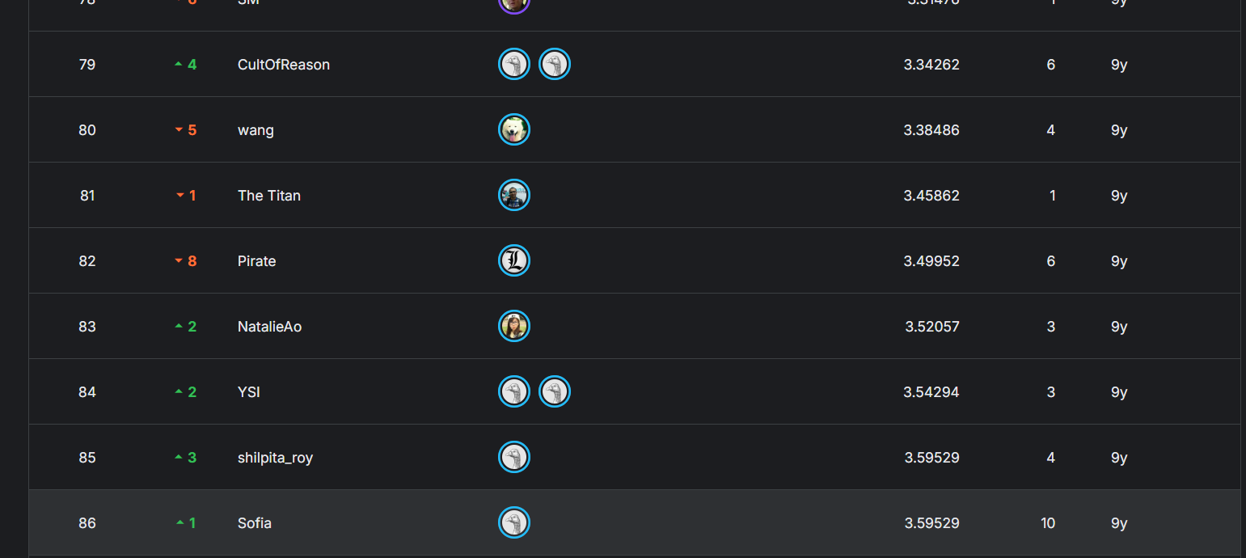
PROJECT RESULTS & ANALYSIS
PERFORMANCE REVIEW
5. Final Results
FINAL SCORE
TOP-LEVEL TARGET
KEY TAKEAWAY
3.58178
The ImprovedCNN with 5-Fold CV achieved a private score of 3.58178. Ensemble of 5 fold checkpoints reduces variance and improves generalization over single-fold training.rovement over the baseline model, but still has clear room for growth compared to the competition leaders (Top 1: 1.28).
Key improvements: BatchNorm for stable training,Dropout2d for spatial regularization,larger head (1024→512→30), and 5-fold ensemble for robust submission.ing the power of deep learning for this image-based regression task.
Private: 3.58178 | Public: 3.81359 Metric: RMSE (masked, lower = better)
COMPETITION RANKING & COMPARISON
ERROR ANALYSIS
Remaining gap to top-1 (≈1.28): no data augmentation, no coord normalization, no LR schedule, no heatmap regression. cases:
SDSC8007 • Mini Project • Facial Keypoints Detection
07
Notes:
这是我们的最终结果。我们的最佳模型在测试集上取得了3.59529的分数，在竞赛中排名第85位。虽然相比基线有了很大提升，但与第一名的1.28236分相比仍有差距。关键结论是，CNN模型是我们成功的核心。通过对比图可以看到，顶尖选手的分数显著更低。错误分析显示，模型在处理遮挡、极端姿态的人脸时表现不佳，这是未来需要改进的方向。

Slide 8
SDSC8007 • MINI PROJECT
EXPLAIN THE MODELING JOURNEY
6. Discussion & Reflection
WHAT WORKED
WHAT DID NOT WORK
KEY INSIGHTS
Method: ImprovedCNN with BatchNorm, Dropout2d, and 5-fold cross-validation ensemble.
Why: BN stabilizes training, Dropout2d prevents spatial co-adaptation, ensemble reduces variance.
Evidence: Private score improved from ~3.81 (baseline) to 3.58 (improved) on Kaggle.
Not yet tried: Data augmentation (flip/rotate/brightness) — planned as future work.
Issue: Current pipeline trains on raw 96×96 pixels without coordinate normalization.
Next: Normalize coords to [-1,1], add augmentation, try heatmap regression.
Masked loss is essential: computing RMSE only on present labels avoids gradient bias from missing annotations, which was the key design decision in this project.of-the-art models require robust augmentation to handle edge cases.
LIMITATIONS & NEXT STEPS
The current 3-block CNN is competitive but leaves headroom. Stronger architectures and better training recipes can close the gap to the top leaderboard.r challenges with edge cases and architectural simplicity.
LIMITATION 1
No data augmentation — model may overfit to unaugmented training distribution.
LIMITATION 2
Simple 3-block CNN — ResNet-like backbone or heatmap regression could improve accuracy significantly.
NEXT STEP
Add augmentation, coord normalization, cosine LR schedule, early stopping, heatmap regression.
SDSC8007 • Mini Project • Facial Keypoints Detection
08
Notes:
现在我们来进行讨论与反思。本次项目中最成功的部分是采用了CNN模型，它显著提升了预测精度，证明了深度学习在图像处理任务中的强大能力。然而，一些尝试并未取得预期效果，比如简单的数据增强。这可能是因为增强的力度不够。项目的主要局限性在于模型对极端姿态和遮挡的人脸处理能力不足。未来，我们计划尝试更先进的网络架构，如ResNet，并采用更复杂的数据增强技术来进一步提升模型性能。

Slide 9
SDSC8007 • MINI PROJECT
DISCLOSE CLEARLY
7. AI Usage & Reproducibility
AI TOOL USAGE
REPRODUCIBILITY CHECKLIST
GitHub Copilot was used for code completion and debugging assistance. All model architecture choices, training design, and preprocessing pipeline were made independently.he group.
✓ Random seed fixed: --seed 42 (torch, numpy, random, sklearn KFold)
Tool:GitHub Copilot
✓ Dependencies: requirements.txt (torch, sklearn, numpy, pandas, tqdm)
Purpose: Code autocompletion and syntax suggestions to speed up implementation of data.py, models.py, train.py, predict.py.
✓ Training: python train.py --data-dir data --output-dir artifacts (5-fold, AdamW, 20ep, bs=64)
Independent Work: All core designs — CNN architecture, K-Fold strategy, masked loss, ensemble inference — designed independently.
✓ Code: github.com/VioletEG/facial-keypoints-detection (PYTHONPATH=src)
✓ Metric: rmse_with_mask(pred, target, mask) — only labeled keypoints counted
Disclosure: AI tools used as productivity aids only; core intellectual contribution is the author's own work.
✓ Inference: python predict.py --data-dir data --artifacts-dir artifacts → submission.csv
SDSC8007 • Mini Project • Reproducibility & AI Tools
09
Notes:
关于AI工具的使用和项目的可复现性。在项目中，我们使用了GitHub Copilot作为代码辅助工具，主要用于自动补全和调试，以提高编码效率。但所有核心的模型设计、数据处理策略和实验流程均由团队独立完成。为了确保可复现性，我们已经记录了所有必要的信息，包括随机种子、环境配置、训练参数、代码链接以及指标计算细节，任何人都可以根据这些信息复现我们的实验结果。

Slide 10

Appendix slides you may add after this page
Q&A
• More ablation details
• Extra EDA plots
• Architecture diagram / training curve
• Failure cases / qualitative examples
• Backup answers for validation and reproducibility
Thank you
For your attention
SDSC8007 • Facial Keypoints Detection • VioletEG
10
Notes:
我的报告到此结束。感谢大家的聆听。现在是问答环节，欢迎大家提问。如果需要，我们也准备了附录幻灯片，包含更多关于实验细节、数据可视化和模型架构的信息。谢谢！

